Slide 1
SQL Wars l’attacco dei cloni e la ribellione dei container
Alessandro Alpi e Giuliano latini

Slide 2
Sponsors

Slide 3


Speaker bio
Alessandro Alpi
Giuliano Latini
suxstellino
giulianolatini
@suxstellino
@giulianolatini
suxstellino
giulianolatini

Slide 4
We have been faced with three tricky issues
Debug our apps against production data (also for edge cases)
Execute perf and integration tests against prod databases
Review the deployment scripts in use to prevent regressions

Slide 5
Everything led to “provisioning”
You can get real, production data in a minute
Automating the process of data generation is easy
You end up using this data in non-production env

Slide 6
With these requirements
Real, anonymized data (via obfuscation)
Isolated, repeatable tests
Short feedback cycle

Slide 7
Approaches

Slide 8
Classic approaches
Restore production databases
Bulk Load via ETLs or SQL scripts
Copy between servers via SQL scripts

Slide 9
Modern approaches
Native clones (DBCC CLONEDATABASE)
Virtual clones (SQL Clone by RedGate)
Containers (Docker)

Slide 10
SQL Clone

Slide 11
Behind the hoods
Source: Data-Image
Full-byte copy of the source database
From backup/live database
Isolated object: Clone
Isolated copy of the database
Created in less than 30sec
Each data-image can generate many clones

Slide 12
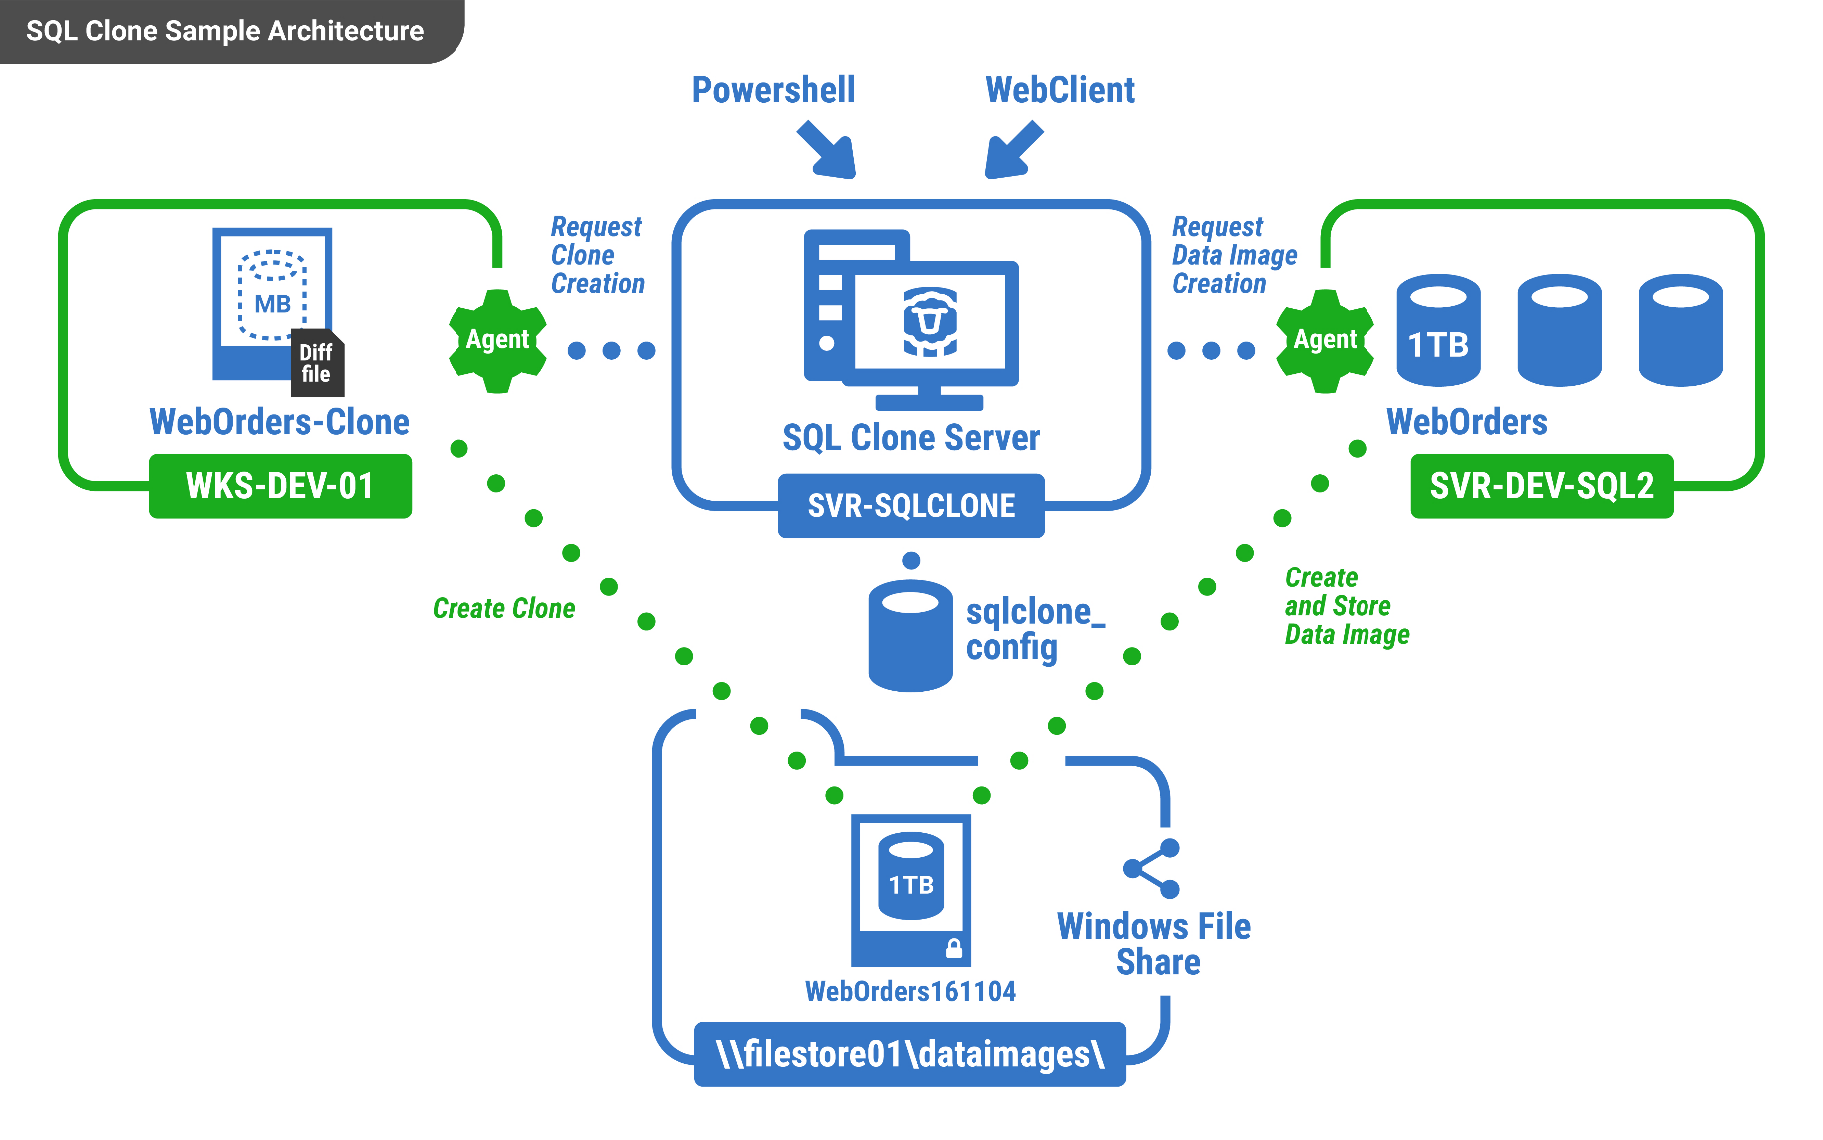
Architecture

Slide 13
Containerizing…

Slide 14
Container
Run SQL engine with less footprint
running on multiOS environment
high and quickly consolidation
Infrastructure as Code
on-premise or in the cloud – no difference
Isolated object to access data
COW fs features have zero costs to resolve write collision
multiple engine access same data
writing and pesistences isolation

Slide 15
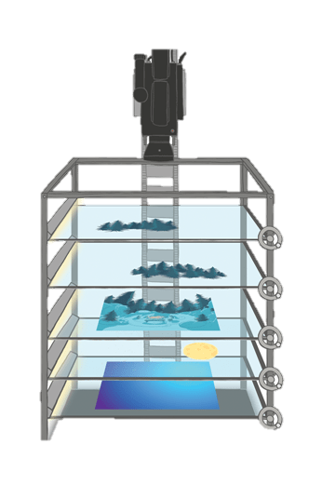
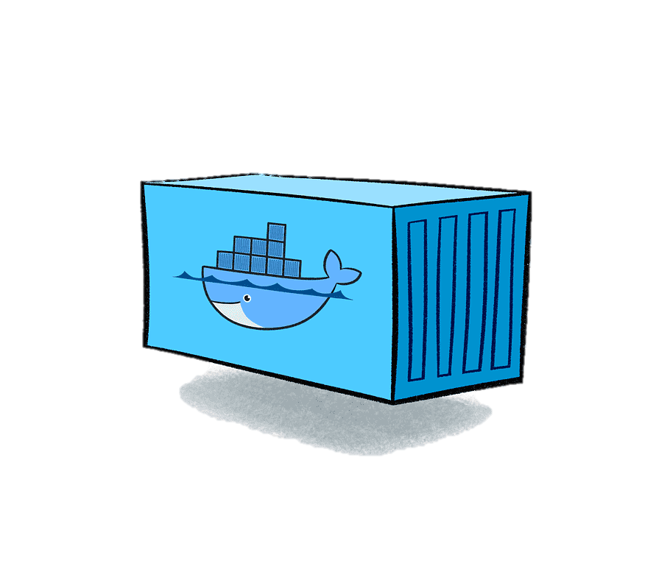

Container
SQLTEST
SQLTEST
SQLPROD

Slide 16
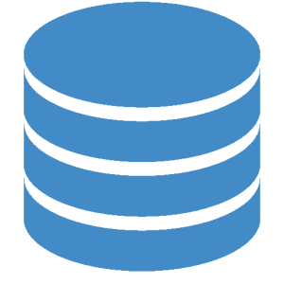
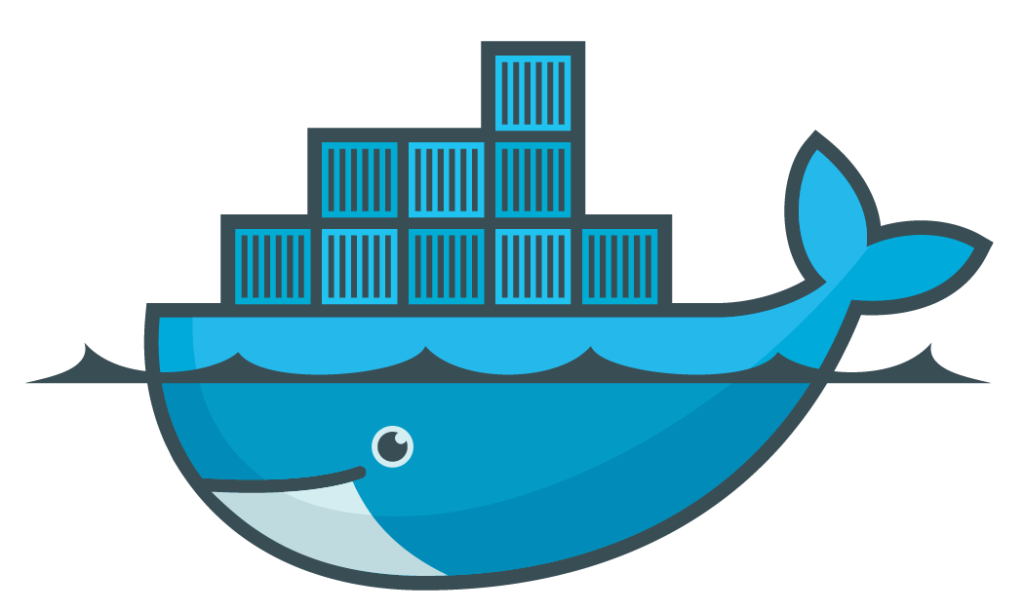
Container
SQL TESTSUITE1
docker run -d \
-v db:/data sql
SQL PRODUCTION
docker run -d \
–v db:/data sql
docker volume create db

Slide 17
SqL Clones vs Containers
Containers
Quick, isolation
Cross platform
Production must be already «containerised»
Sql Clone
Quick, isolated
Windows-only
Perfect for classic VMs (no container support)

Slide 18
Resources
DBCC CLONEDATABASE: https://docs.microsoft.com/en-us/sql/t-sql/database-console-commands/dbcc-clonedatabase-transact-sql?view=sql-server-ver15
SQL Clone: https://www.red-gate.com/products/dba/sql-clone/
Docker for SQL Server: https://docs.microsoft.com/en-us/sql/linux/quickstart-install-connect-docker?view=sql-server-ver15&pivots=cs1-bash
Docker Hub: https://hub.docker.com/_/microsoft-mssql-server
Microsoft Container Registry: https://azure.microsoft.com/en-us/services/container-registry/

Slide 19
Resources
Volume Shadow Copy: https://msdn.microsoft.com/en-us/library/windows/desktop/bb968832(v=vs.85).aspx
Differencing Virtual Hard disk: https://technet.microsoft.com/en-us/library/cc720381(v=ws.10).aspx
StackOverflow database: https://www.brentozar.com/archive/2015/10/how-to-download-the-stack-overflow-database-via-bittorrent/
SQL Clone on AzureDevOps: https://www.youtube.com/watch?v=fVbmUZ6FhEc

